Slide 1
1 – Clean Code
Based on the CleanCoders videos by Uncle Bob Martin
Rupert Waldron

Slide 2
Why Clean Code?
The Sword debugger story…
Sword created a fantastic C debugger that allowed programmers to debug without the use of a Hex editor – great product and the money flowed in.
Then developers moved to C++, the next release of Sword was months late, took 45mins to load and then crashed. Months later Sword declared bankruptcy.
What happened to Sword:
The marketing dept said if they weren’t first to market with the C debugger then there was no point starting… so the developers rushed. Resulting in messy code which was hard to get going and very temperamental.
New features for customers were continuously added and took priority over cleaning the code.
Then the marketing dept wanted the debugger to work with C++.
Whatever they did they couldn’t get it to work with C++ and the C market dwindled.

Slide 3
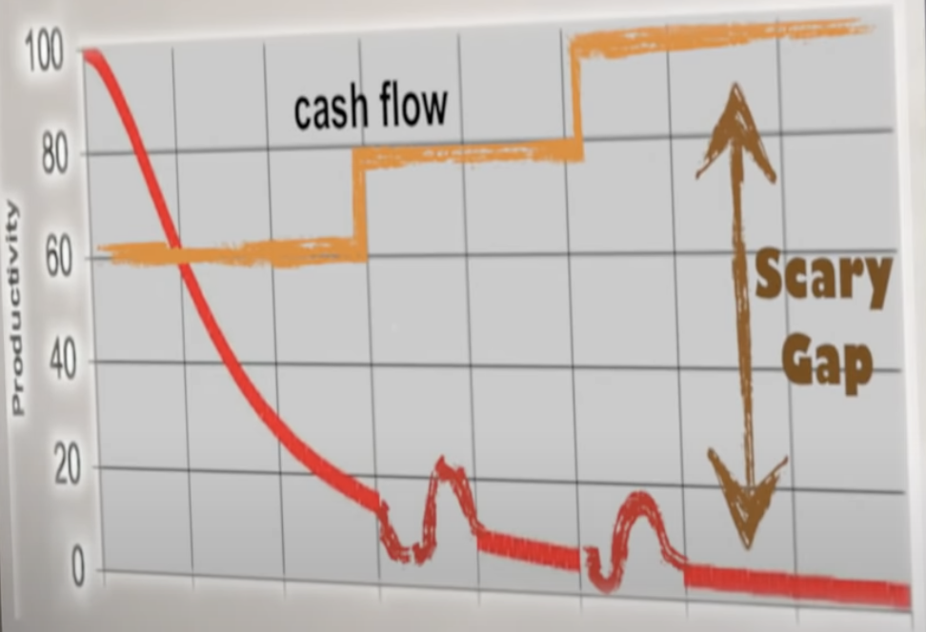
The Productivity Trap
Green Field Projects – The features get added quickly, programmers feel like heroes.
After a few months the features get harder to add. A mess is starting to build in the code, now it takes longer and longer to add new features. Management’s plans see a gap…
Management don’t understand why you’ve slowed down… so they hire more programmers
Productivity slows while the current programmers teach the new programmers, but the old code is also teaching the new programmers (how things are done around here). Soon they start to emulate the practices that created the mess in the first place. The mess continues to grow.🧶
Only now the business is spending more money on the new staff. The gap gets bigger, and bigger.
The management ask the programmers what they should do to increase the productivity…. “Start over, throw it all away”
The management don’t like the risk and the cost, but what choice do they have they have tried everything else.
Management pick the ten best programmers to do the redesign.. The Tiger Team 🕺. The ones who made the mess in the first place.
The requirements aren’t in a document anymore, they are buried in the old code. Meanwhile the other developers are fixing bugs and adding new features to the old code. The two groups are in a race.

Slide 4
The Productivity Trap Cont…
In the end the managers replaced the old system with the new system even though it lacked some of the features of the old system. The customers weren’t happy.
The Tiger team had long since gone onto bigger and better things. The developers on the new system said it wasn’t ready to be deployed… it needed a redesign 🫣.
The Redesign Approach can work for very small projects, but almost certainly results in waste of time and money for anything of size and complexity.
That is how bad software can destroy a team, division even a company. 💣
The only way to deal with this mess is to clean the code.

Slide 5
What are the features of bad code
Rigidity – Resistance to change
A system is rigid if we are required to make many changes in multiple places to fix a single bug. That small bug fix, causes a problem in another module, then you fix that module… ad infinitum. Ever hear the phrase “It was more complicated than I thought”? 😞
Fragility
A small change to one system causes other systems to misbehave in unusual ways. Managers and customers read this as programmers have lost control of their software.
Inseparability
Parts of a system that could be profitably used elsewhere can’t be separated out from the original system.
Opacity
Structured so badly that one can not work out the authors original intent. Opaque code is hard to read and hard to change.

Slide 6
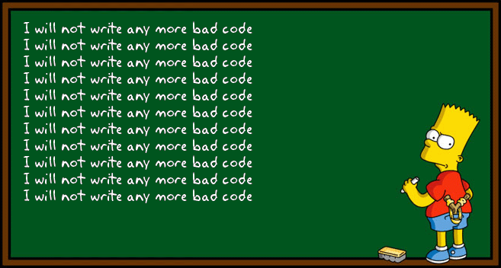
We wrote bad code to go fast
We are the ones who wrote the bad code.
Because we had to go fast to meet the deadlines?
We can go back and clean it later… this never happens as urgency never diminishes.
If you want to go fast you have to go clean.
If you rush through code, you always end up slowing down in the short-term and the long-term.

Slide 7
What is clean code?
Code that is easy to understand and easy to change.
Code that is what you expect.
Code that is easy for your colleagues to read.

